Slide 1
September 27, 2020
The Son of God Betrayed
Mark 14:42-52
The Authenticity, Affliction and Authority of Jesus Christ, the Son of God

Slide 2
Mark 14:42-46
42 “Get up, let us be going; behold, the one who betrays Me is at hand!” 43 Immediately while He was still speaking, Judas, one of the twelve, came up accompanied by a crowd with swords and clubs, who were from the chief priests and the scribes and the elders. 44 Now he who was betraying Him had given them a signal, saying, “Whomever I kiss, He is the one; seize Him and lead Him away under guard.” 45 After coming, Judas immediately went to Him, saying, “Rabbi!” and kissed Him. 46 They laid hands on Him and seized Him.

Slide 3
Mark 14:47-52
47 But one of those who stood by drew his sword, and struck the slave of the high priest and cut off his ear. 48 And Jesus said to them, “Have you come out with swords and clubs to arrest Me, as you would against a robber? 49 “Every day I was with you in the temple teaching, and you did not seize Me; but this has taken place to fulfill the Scriptures.” 50 And they all left Him and fled. 51 A young man was following Him, wearing nothing but a linen sheet over his naked body; and they seized him. 52 But he pulled free of the linen sheet and escaped naked.

Slide 4
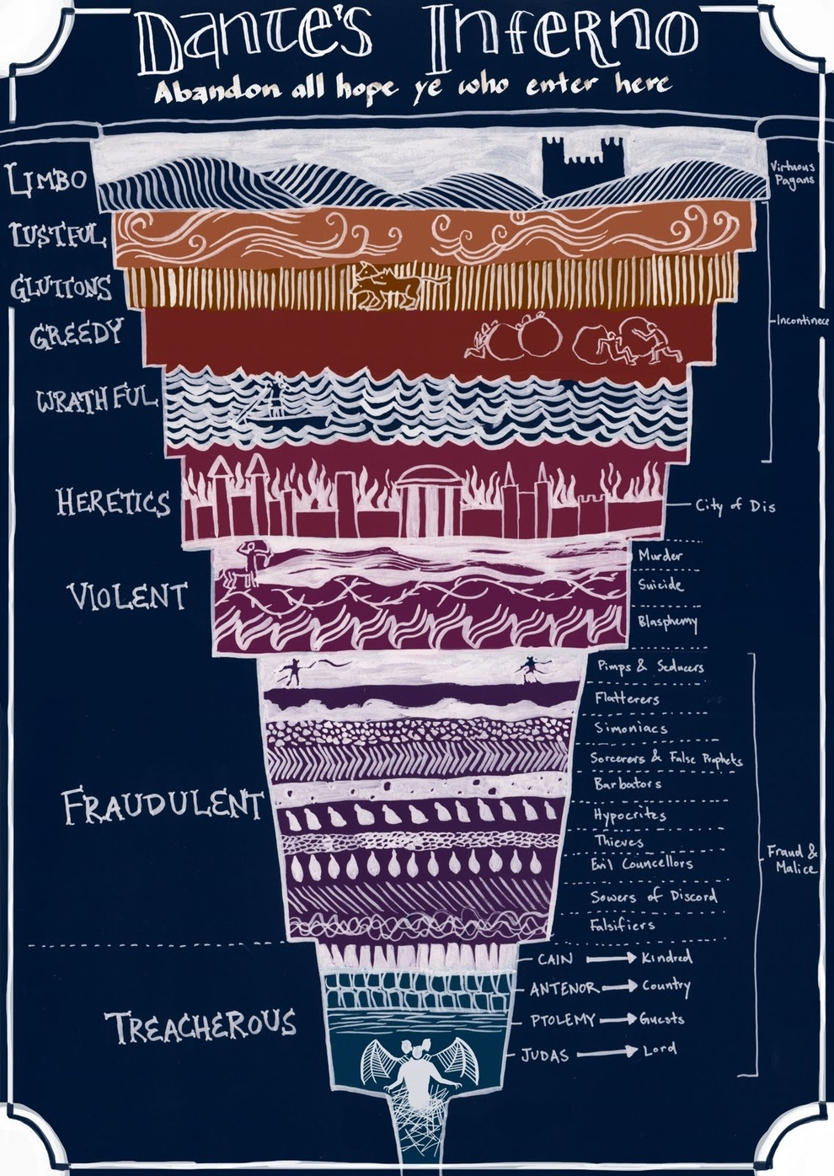

Slide 5
A colluding crowd ^{(14:42-46)}
42 “Get up, let us be going; behold, the one who betrays Me is at hand!” 43 Immediately while He was still speaking, Judas, one of the twelve, came up accompanied by a crowd with swords and clubs, who were from the chief priests and the scribes and the elders. 44 Now he who was betraying Him had given them a signal, saying, “Whomever I kiss, He is the one; seize Him and lead Him away under guard.” 45 After coming, Judas immediately went to Him, saying, “Rabbi!” and kissed Him. 46 They laid hands on Him and seized Him.
Judas is the leader of this hostile crowd
Judas is part of a larger collusion

Slide 6
A careless companion ^{(14:47)}
But one of those who stood by drew his sword, and struck the slave of the high priest and cut off his ear.

Slide 7
A courageous Christ ^{(14:48-49)}
48 And Jesus said to them, “Have you come out with swords and clubs to arrest Me, as you would against a robber? 49 “Every day I was with you in the temple teaching, and you did not seize Me; but this has taken place to fulfill the Scriptures.”

Slide 8
A compromising company ^{(14:50-52)}
50 And they all left Him and fled. 51 A young man was following Him, wearing nothing but a linen sheet over his naked body; and they seized him. 52 But he pulled free of the linen sheet and escaped naked.

Slide 9
September 27, 2020
The Son of God Betrayed
Mark 14:42-52
The Authenticity, Affliction and Authority of Jesus Christ, the Son of God

